Slide 1

CSI 758 Project Kaggle Data Science Bowl 2017 Lung Cancer Detection
Bruce Goldfeder
May 4, 2017

Slide 2
Understanding the Data
Anonymized, high-resolution lung scans from hundreds of patients low-dose CT technology scans.
Three Data Sets of DICOM images
Sample set of 20 Dicom, Stage1(70GB), Stage2(40GB)
Each DICOM image had approximately 100 - 200 sub-images
2D layer of the scan – each of size [512,512] in color
Aggregated makes a 3D image
Label File with Binary of Has Cancer = 1, No Cancer = 0
Subset of patients identified to be used as training set
Number of
Sub-Images Cancer? Image Size
=====================================
134 0 (512, 512)
128 0 (512, 512)
133 0 (512, 512)
110 0 (512, 512)
203 1 (512, 512)
id | cancer
0015ceb851d7251b8f399e39779d1e7d | 1
0030a160d58723ff36d73f41b170ec21 | 0
003f41c78e6acfa92430a057ac0b306e | 0
006b96310a37b36cccb2ab48d10b49a3 | 1

Slide 3
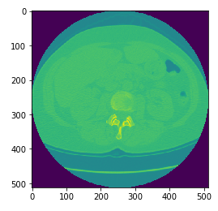
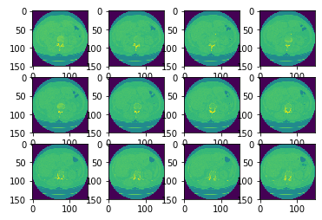
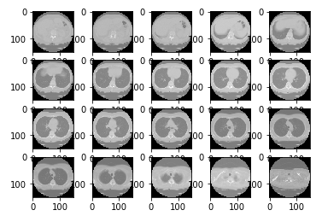
Visualizing and Conditioning the Data
Convolutional Neural Nets (CNN) use small image sizes typically 64x64 or smaller and the same number of inputs
This presents a conditioning problem in how to get [512,512] x ~200 layers into that format!!!
Techniques – Resize, Chunk Layers together to same number per Dicom using an averaging function
Original 2D Slices
Resized 2D Slices
20 “Chunks” per Dicom

Slide 4
Pre-Process Data for 3D CNN
Needed to accommodate variance in number of images per Dicom
Used chunking function with adjustments
Approximated the number of images to get 20 groups of adjacent images
Averaged the pixel values over the range of adjacent images to normalize for each group
Some data fidelity loss – estimate that tumor size that could be observed moved from millimeters to about a centimeter in size due to averaging.
Result was approximately 1500 images each with 50 pixels by 50 pixels by 20 images – this is the basis for the common 3D model to be input to the CNN

Slide 5
3D CNN Using Tensor Flow
Epoch 1 completed out of 10 loss: 238734260925.0
Accuracy: 0.6
Epoch 2 completed out of 10 loss: 18683134593.9
Accuracy: 0.7
Epoch 3 completed out of 10 loss: 7478595325.29
Accuracy: 0.7
Epoch 4 completed out of 10 loss: 3809845549.84
Accuracy: 0.9
Epoch 5 completed out of 10 loss: 2490083642.7
Accuracy: 0.4
Epoch 6 completed out of 10 loss: 1678082050.97
Accuracy: 0.5
Epoch 7 completed out of 10 loss: 1223602945.69
Accuracy: 0.6
Epoch 8 completed out of 10 loss: 760098937.574
Accuracy: 0.8
Epoch 9 completed out of 10 loss: 433012339.411
Accuracy: 0.9
Epoch 10 completed out of 10 loss: 242587365.832
Accuracy: 0.6
Done. Finishing accuracy:
Accuracy: 0.7
fitment percent: 0.9992790194664743
Difficult to install – both hardware and software dependencies
In future will use pre-built AWS Data Science AMI on Ubuntu
Not Instance Type transportable
Data was reduced dramatically
512x512x200 = 52MB to 50x50x20 = 50K; 99.9% loss
Still this was a large amount of data for a CNN
Works great on 2D kitten images of 64x64 = 4K
Not enough data samples
CNN wants 100K or more sample size

Slide 6
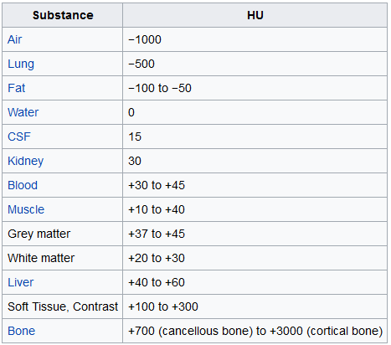
Apply Domain Knowledge
Hooray, a successful data ingestion, transformation, and CNN run!
Now for the hard part ☺ Apply Domain Knowledge, Semantics, Ontology
Also apply further normalization and conditioning of the data
Apply the following set of steps (thanks to Guido Zhuidhoff)
Loading the DICOM files, and adding missing metadata
Converting the pixel values to Hounsfield Units (HU), and what tissue these unit values correspond to
Resampling to an isomorphic resolution to remove variance in scanner resolution.
3D plotting, visualization is very useful to see what we are doing.
Lung segmentation
Normalization that makes sense.
Zero centering the scans.

Slide 7
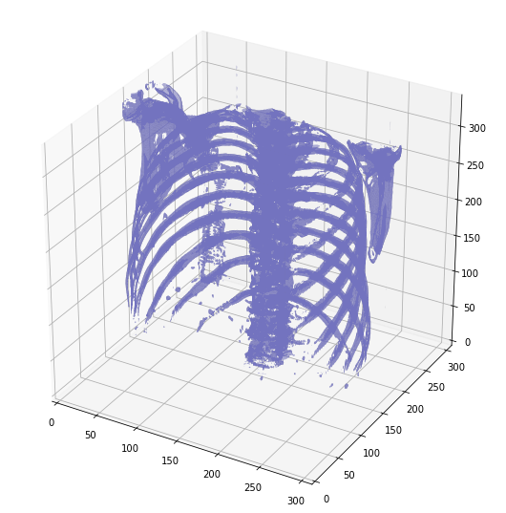
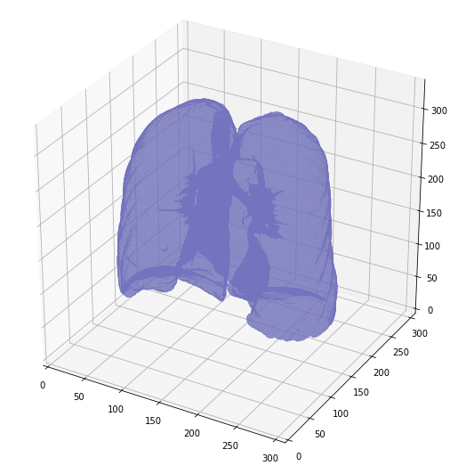
Lung Segmentation
Segmented Lung Mask
Threshold at -320 including structures in the lungs
Just bones ~400HU
1. Apply morphological function to expand mask in all directions
2. Multiply binary segmented lung mask time the full resampled image
3. This leaves you just the lungs!
Then run this new data set with just the lungs through the original process. Rinse and Repeat with new data, new choices, new experiments
Last step, submit work, get paid, drink beer ☺

